Slide 1
Getting Started with Test Automation
Part 1 (still a work in progress…)

Slide 2
Why Automate Tests (or ‘Checks’)
Faster test execution = faster releases
Checking vs Testing
‘Testing’ is an intellectual activity
‘Checking’ is scripted and often monotonous
The rise of Agile, DevOps, and Continuous Deployment require a highly automated release mechanism. This includes testing.

Slide 3
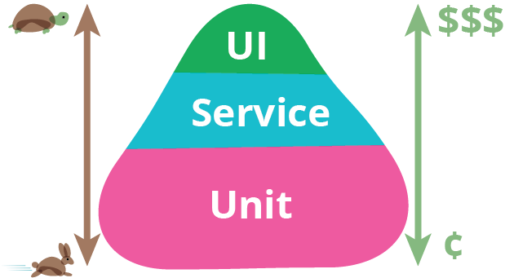
The Test Automation Pyramid
*Test Automation Pyramid concept is generally attributed to Mike Cohn

Slide 4
Unit Tests
TDD - Test Driven Development
ATDD - Acceptance Test Driven Development
BDD - Behavior Driven Development
xUnit Test Frameworks: JUnit, NUnit, PyUnit, CppUnit
Mocha

Slide 5
API Tests
What is an API (Application Programming Interface)?
Web Services as a means of abstraction
SOAP - Simple Object Access Protocol
A formal contract, described via WSDL (Web Services Definition Layer)
REST - Representational State Transfer is architectural style, usually over HTTP
Lightweight, usually message formats are XML and JSON

Slide 6
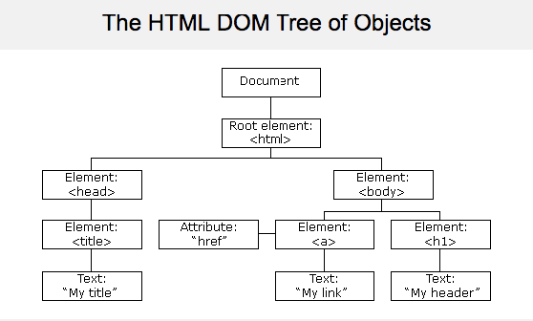
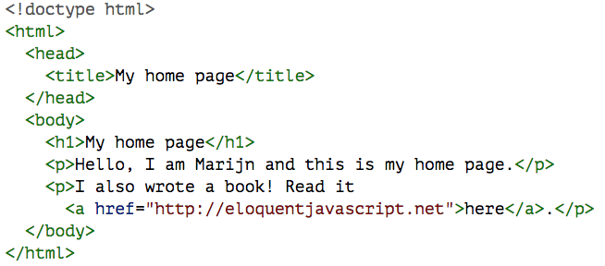
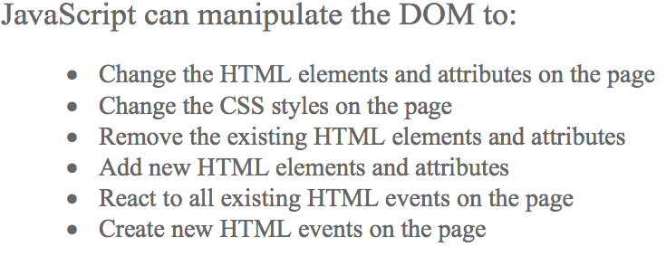
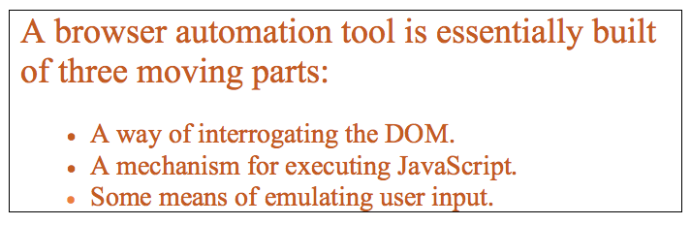
GUI Tests (For simplicity’s sakes, a web browser)

Slide 7
So Why Focus on GUI Test Automation First?
Easiest for most people to relate because this is the end user perspective
Always going to need to do some testing at GUI layer
Selenium (səˈlēnēəm) - What is it?
Selenium RC / Selenium IDE - uses the browser Javascript engine
Selenium Webdriver - a true browser API, now adopted by all major browser vendors

Slide 8
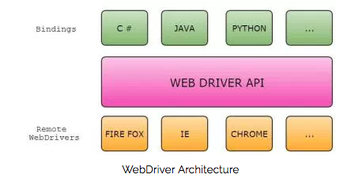
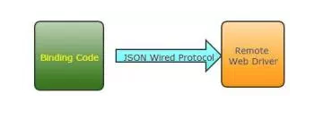
Selenium Webdriver - how it works
Selenium Language Bindings - How to choose a language
Prior knowledge or experience
Ease of use
Match the Development Stack
Popularity
JSONWire Protocol

Slide 9
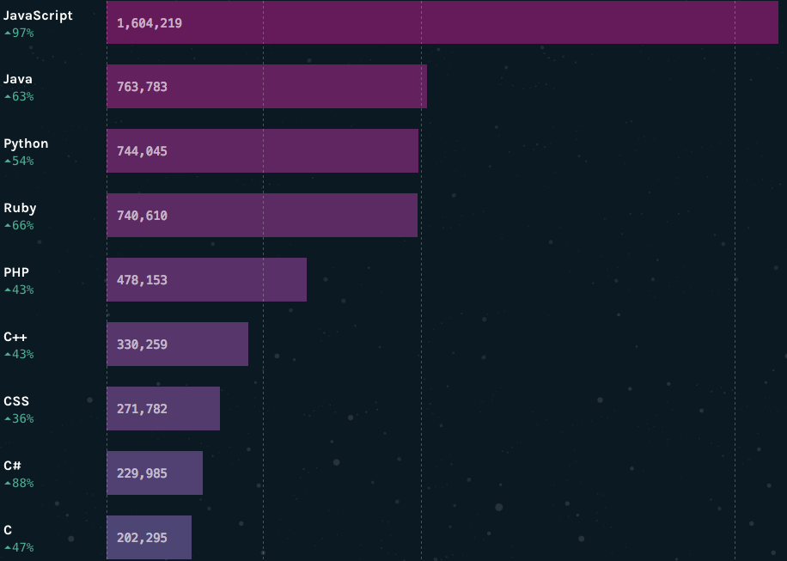
IT Trends (Why JavaScript?)
GitHub Pull Requests in 2016 (number of open source project changes)
Source: https://octoverse.github.com/

Slide 10
JavaScript
JavaScript (definition): the most unfortunately named programming language that has absolutely nothing to do with the Java language. https://www.w3.org/community/webed/wiki/A_Short_History_of_JavaScript
Rapidly Evolving Language Spec - Seven versions of the language spec in its 20 years of existence (ES2016 was finalized in June 2016)
https://en.wikipedia.org/wiki/ECMAScript
JS continues to be the front end technology that powers the web.
Now, the unthinkable has happened: Server Side JavaScript. Meet Node.js

Slide 11
Back to Selenium (lots of JS options)
WebdriverIO
http://webdriver.io/
Nightwatch
http://nightwatchjs.org/
Testium
https://github.com/groupon/testium
Nightwatch
https://github.com/SeleniumHQ/selenium/wiki/WebDriverJs
WebDriverJs
https://github.com/SeleniumHQ/selenium/wiki/WebDriverJs

Slide 12
Setting Up Node.js and Webdriver
Note: on Windows machines, you will need administrative rights to install Node.js and packages from npm
Install Node.Js (Windows 64-bit) https://nodejs.org/dist/v6.9.5/node-v6.9.5-x64.msi
Open a cmd prompt (as Administrator)
  npm install selenium-webdriver@latest -g
  npm install -g mocha
  mkdir test
  npm install -g geckodriver
  npm install -g chromedriver

Slide 13
WebDriver References
Element Locators
https://saucelabs.com/resources/articles/selenium-tips-css-selectors
http://axatrikx.com/xpath-css-path-cheat-sheet/
http://cssify.appspot.com/
https://www.simple-talk.com/wp-content/uploads/imported/1269-Locators_table_1_0_2.pdf
https://www.simple-talk.com/wp-content/uploads/imported/1269-Locators_groups_1_0_2.pdf
WebDriverJs and Mocha
https://watirmelon.blog/2015/10/28/getting-started-with-webdriverjs-mocha/
http://watirmelon.com/2015/10/30/webdriverjs-mocha-part-2-hooks/
https://watirmelon.blog/2015/10/30/webdriverjs-mocha-part-3-page-objects/
https://watirmelon.blog/2015/11/02/webdriverjs-mocha-part-4-more-page-objects-config/
Cheat Sheet for Common Selenium Commands
http://axatrikx.com/selenium-webdriver-cheat-sheet/
FireBug (no longer maintained)
http://getfirebug.com/

Slide 14
JavaScript and Node.js References
JavaScript Training
https://www.codecademy.com/learn/javascript
https://developer.mozilla.org/en-US/docs/Learn/JavaScript
Node.js Training
https://www.youtube.com/playlist?list=PL6gx4Cwl9DGBMdkKFn3HasZnnAqVjzHn_
https://nodeschool.io
Mocha
https://mochajs.org/

